Slide 1
NextVanGogh
.com

Slide 2
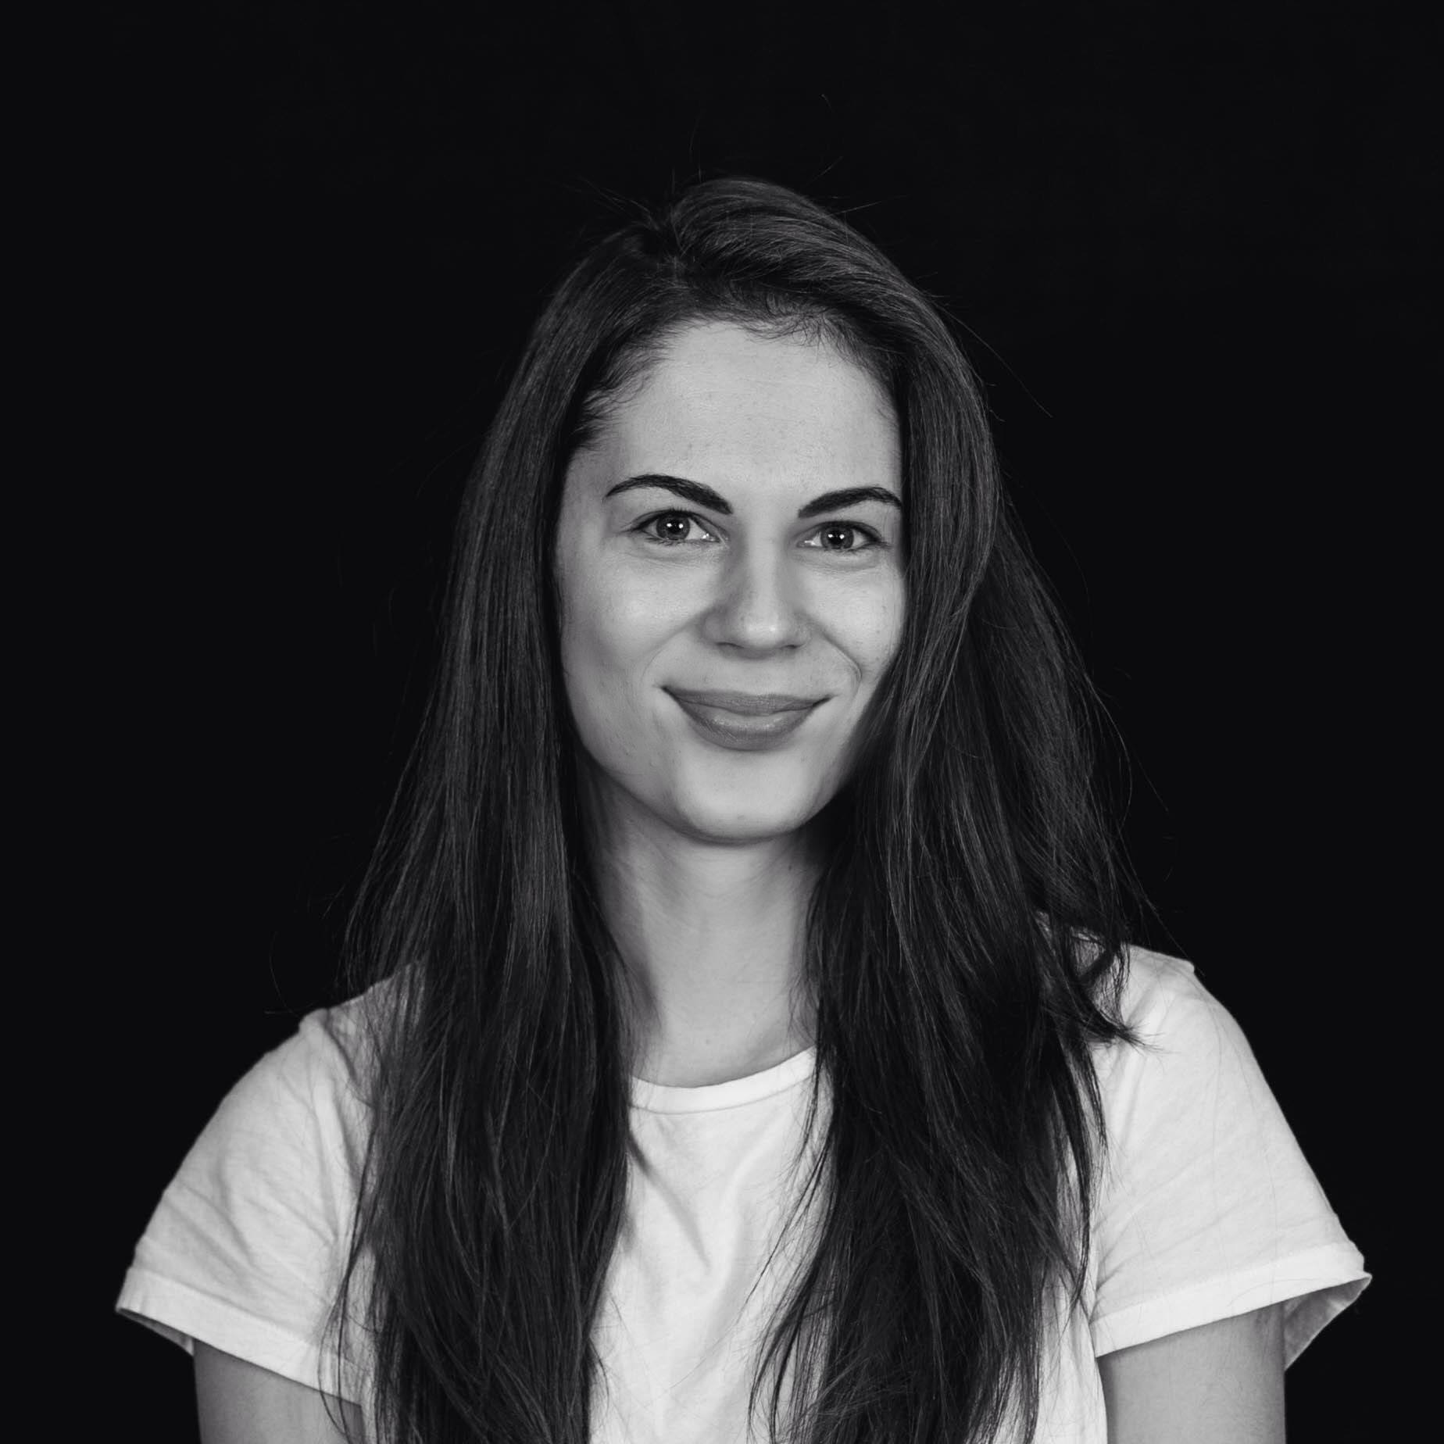

Slide 3
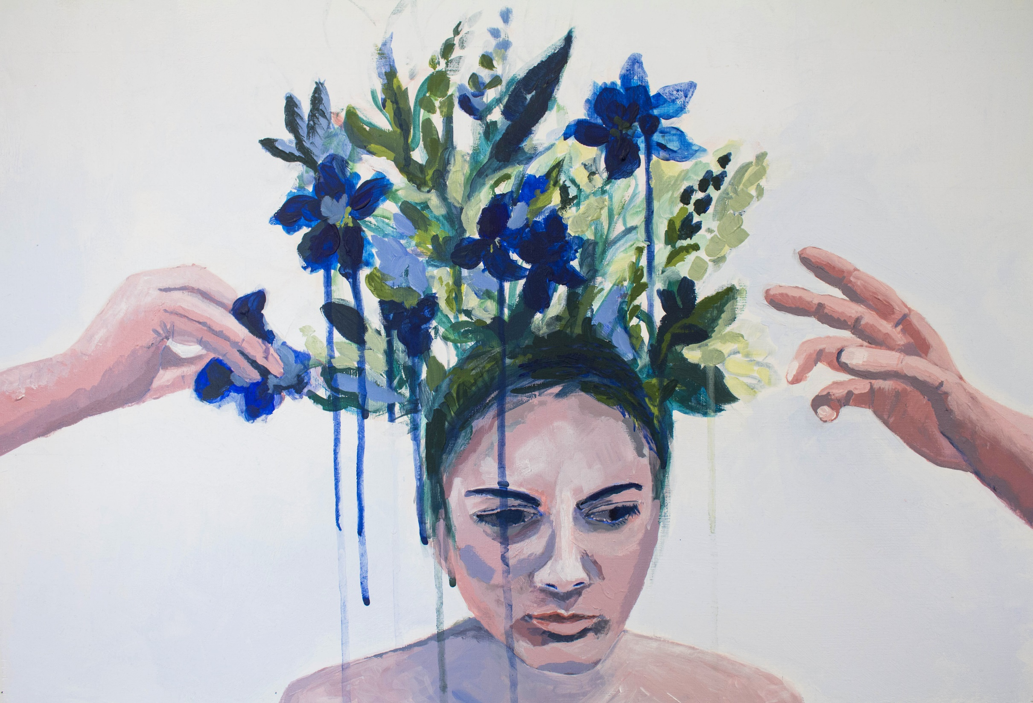

Slide 4
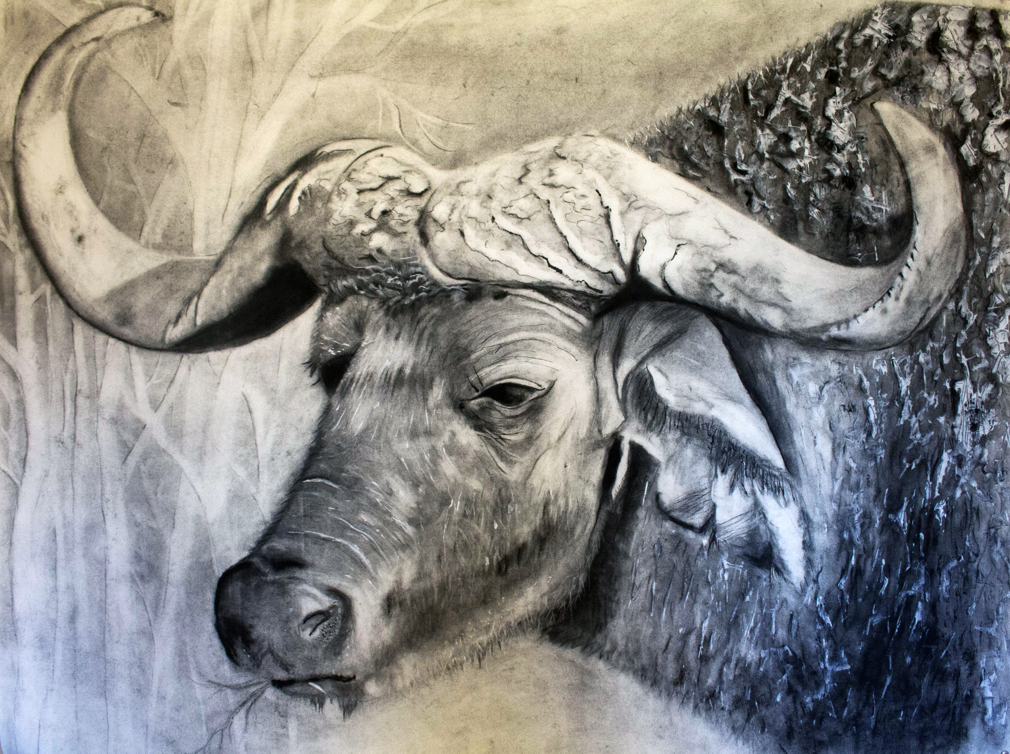

Slide 5
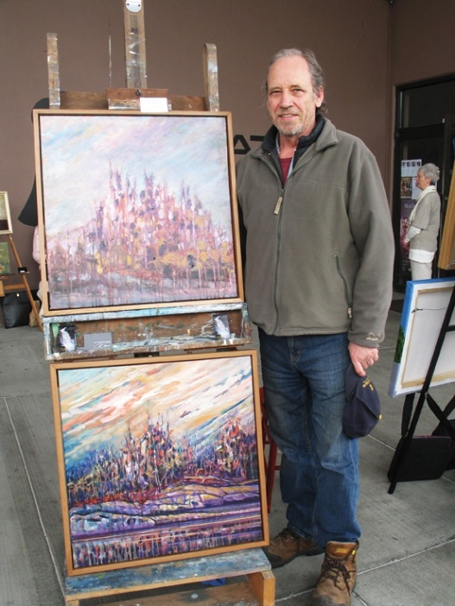
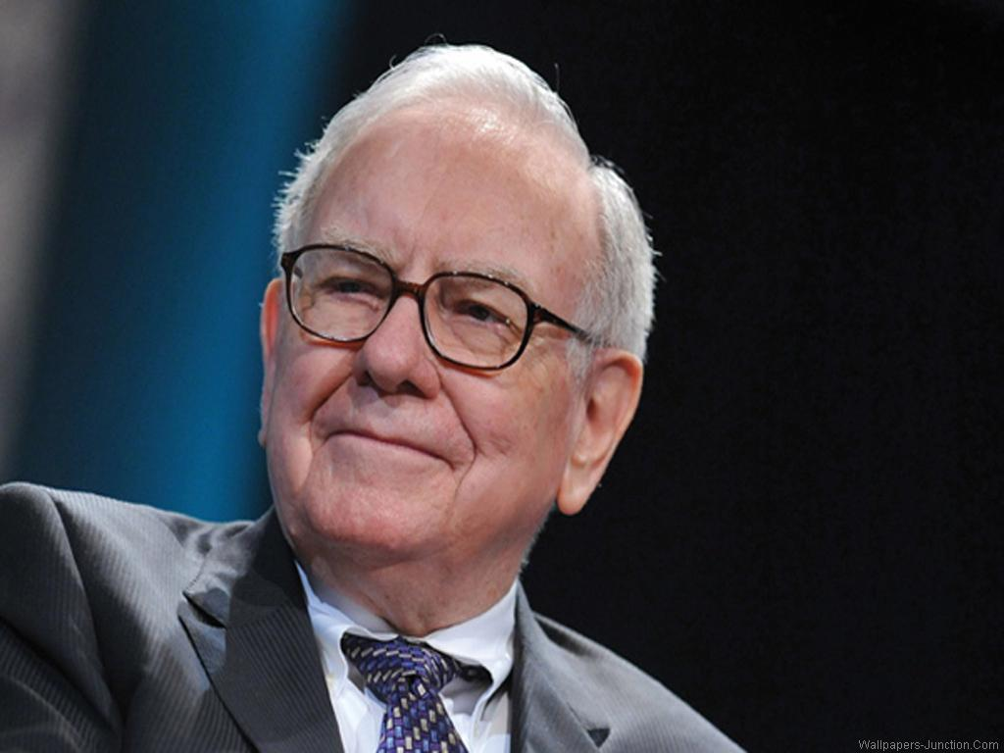
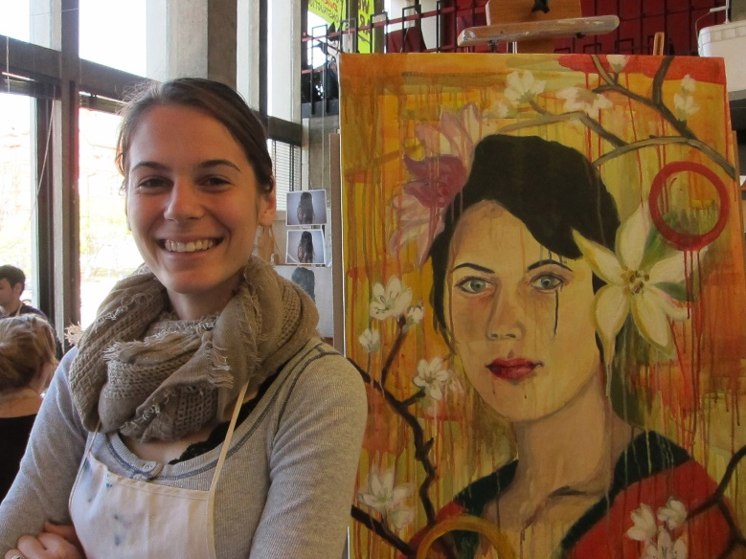
NextVanGogh .com
Invest and support($$$)
Art and sketches
- «Behind the scenes»
Workshops
Private meetings
Tickets to art events

Slide 6



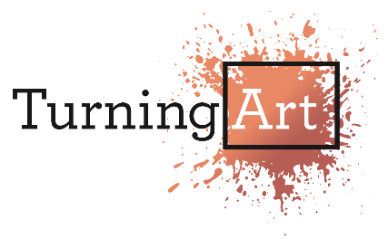
NextVanGogh .com
Team:
Arturs Snegovics – manager, marketing, finances. Bachelor in Arts (Roosevelt Academy, NL)
Nora Biteniece – software engineer, web and technical developer. BSc in Computer Science with Neuroscience (Keele University, UK)
Competition:
Our advantage:
Direct contact between artist and investor
Artist is the priority
Focus on painters
Very little transaction fees
Real life exhibitons and galleries

Slide 7
NextVanGogh .com
Funding:
Marketing activities
Web designer (co-owner)?
Short-term goals:
1q: 100 artists ←→ 10 investors
2q: 500 artists ←→ 50 investors
3q: 5000 artists ←→ 500 investors
4q: 10000 artists ←→ 1000 investors
Long-term goals:
Next Van Gogh gallery
Artists are following their passion
Investors benefit in a long-term
Galleries across the world

Slide 8
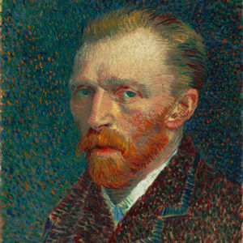
Will we find the
Next Van Gogh?

Slide 9
Yes!

